Slide 1
Developing a device estimation needs tool
February 2026

Slide 2
Starting with CPAP
Objective:
Estimate CPAP machines needed per neonatal facility in low-resource settings.
Support procurement and planning based on clinical need.
Key concept: Device demand driven by patient severity (birthweight), and some slight adjustment for levels of care to avoid over or under estimation in facilities with similar birth weight distribution to reference facility.
Adjustments:
Facility level (II vs III) – these details affects CPAP duration/referral patterns.
Patient severity captured via birthweight mix.
Outcome:
Estimated devices per facility (with operational buffer (10–15%) for surge, maintenance, seasonality).
Gap/surplus for procurement planning.

Slide 3
Scaling device estimation using historical data
Use of Historical Data:
Aggregate birthweight distribution, CPAP rates, and duration from existing hospitals
Apply to new or similar facilities to estimate device needs before operational data exist
Advantages:
Provides evidence-based starting point for procurement
Can be updated once local patient data are available
Considerations:
Assumes similar case-mix and referral patterns
Level III hospitals may require slightly longer CPAP durations
High-acuity or extremely low birthweight cases may need adjustment
Practical Application:
Initial procurement and staffing decisions
Planning across networks of facilities with similar contexts

Slide 4
CPAP devices estimation - methodology
Estimate clinical demand
Calculate facility birthweight distribution
Apply expected % needing CPAP by birthweight group
Compute overall expected CPAP rate (weighted by case-mix)
Expected CPAP % = Σ (Proportion in BW group × Expected CPAP rate for that group)
Convert annual demand to simultaneous need (concurrency)
Use average annual neonatal admissions (multi-year preferred)
Estimate average CPAP duration (facility-specific or level-adjusted)
CPAP devices needed = (Admissions × Expected CPAP % × Avg CPAP days) ÷ 365
This estimates average number of machines needed simultaneously

Slide 5
CPAP – example facility (Level III Regional Hospital)
Annual Admissions: 1,200 neonates per year
BW Group | % of Admissions | Expected % Needing CPAP
≥2500g | 50% | 5%
2000–2499g | 25% | 20%
1500–1999g | 15% | 40%
1000–1499g | 8% | 65%
<1000g | 2% | 85%

Slide 6
CPAP – example facility (Level III Regional Hospital)
Compute expected CPAP %
Weighted sum:
0.50 × 0.05 = 0.025
0.25 × 0.20 = 0.050
0.15 × 0.40 = 0.060
0.08 × 0.65 = 0.052
0.02 × 0.85 = 0.017
Total = 0.204 (20.4%)
> Expected CPAP need = 20.4% of admissions

Slide 7
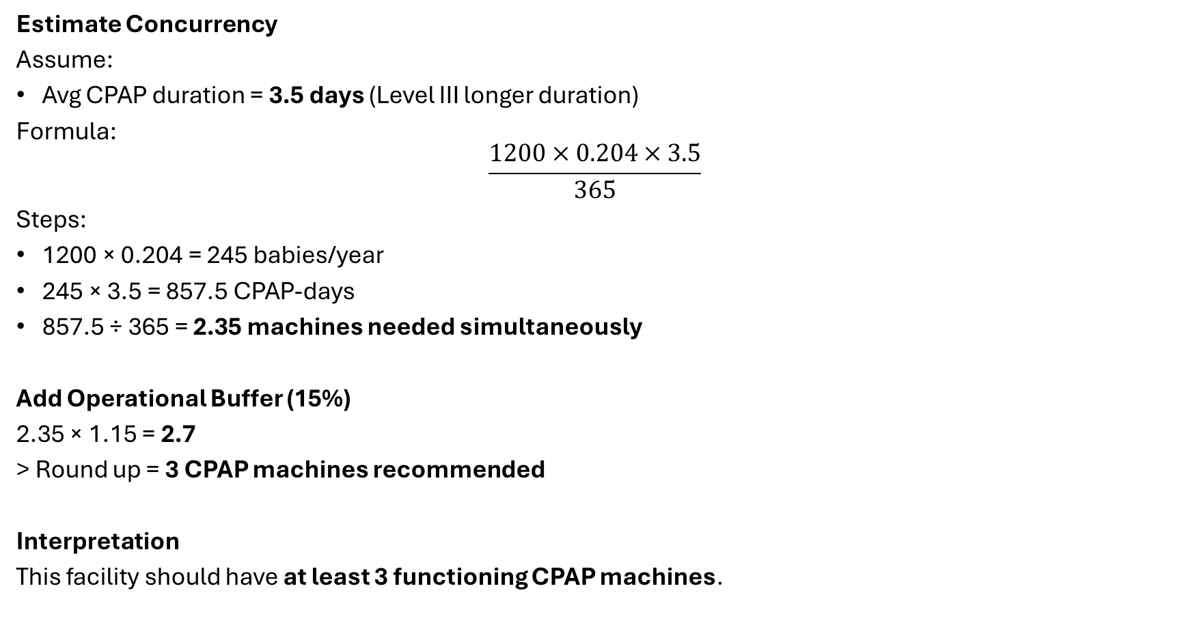
CPAP – example facility (Level III Regional Hospital)
Estimate Concurrency
Assume:
Avg CPAP duration = 3.5 days (Level III longer duration)
Formula:
$$\frac{1200×0.204×3.5}{365}$$
Steps:
1200 × 0.204 = 245 babies/year
245 × 3.5 = 857.5 CPAP-days
857.5 ÷ 365 = 2.35 machines needed simultaneously
Add Operational Buffer (15%)
2.35 × 1.15 = 2.7
> Round up = 3 CPAP machines recommended
Interpretation
This facility should have at least 3 functioning CPAP machines.

